Slide 1

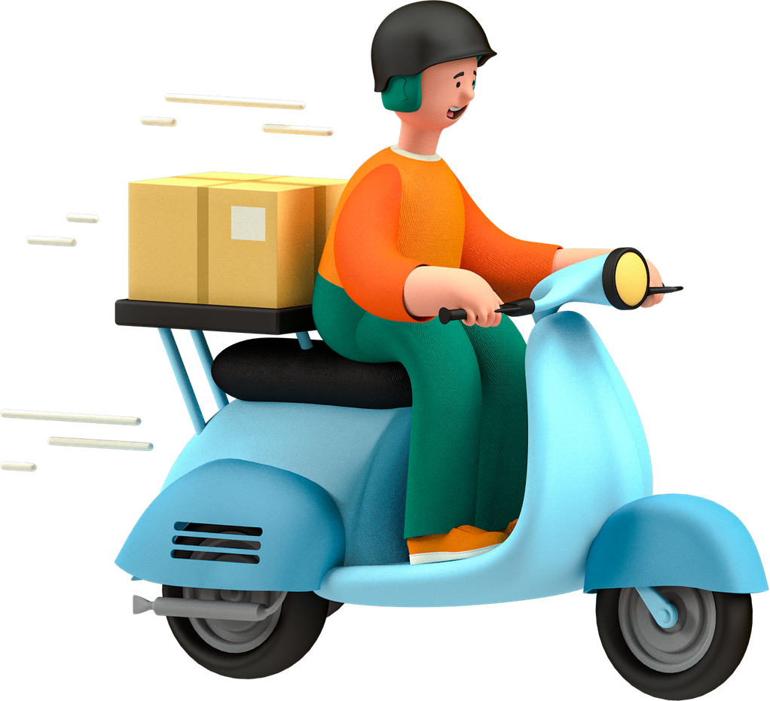
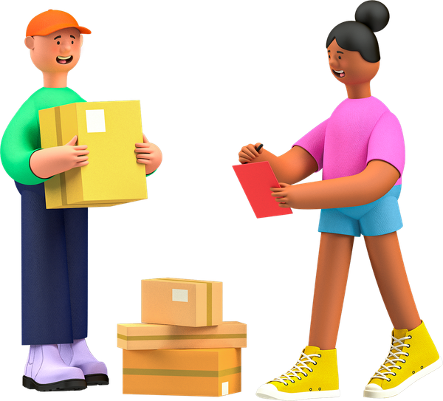
Delivery Route Optimizer
Smart logistics management system
Presented by
M. Laasya Sri 2520090196
M. Rajini 2520090197

Slide 2

Abstract
A browser-based system to plan and monitor daily deliveries.
Takes delivery and vehicle details as input.
Assigns packages to vehicles with a greedy capacity-based method.
Finds shortest paths on a road graph using Dijkstra's algorithm.
Compares a greedy nearest-stop route and keeps the shorter one.
Handles traffic with a traffic factor and re-routing around jams.
Reports distance, time, fuel and cost on an SVG map and charts.
Built with HTML, CSS, JavaScript and an optional Node.js backend.

Slide 3

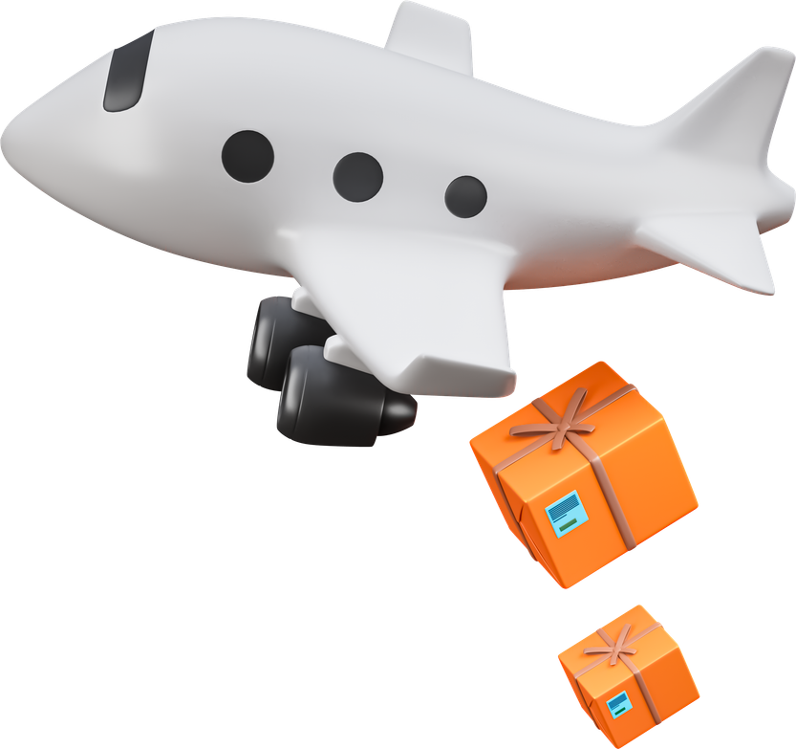
Introduction
Delivery businesses handle many delivery locations every day.
Poor route planning increases distance, fuel use, delivery time and cost.
Vehicle capacity limits how many packages each vehicle can carry.
Customer time windows and traffic add more constraints.
Planning routes by hand is slow and error-prone.
This system automates assignment and routing using Dijkstra and greedy methods to give practical, low-cost routes.

Slide 4

Software Requirements
Software | Requirement
Operating System | Windows 10 / 11
Frontend | HTML, CSS, JavaScript
Backend | Node.js (server.js, no dependencies)
Storage | Browser localStorage, data.json
Algorithms | Dijkstra and greedy, in JavaScript
Map and Charts | SVG and Canvas (no libraries)
Editor | Visual Studio Code + Live Server
Browser | Microsoft Edge / Google Chrome

Slide 5

Hardware Requirements
Hardware | Minimum Requirement
Processor | Intel Core i3 / AMD Ryzen 3 or above
RAM | 4 GB minimum, 8 GB recommended
Storage | 1 GB free space
Display | 1366 × 768 resolution or higher
Internet | Not required (runs locally)
Input Devices | Standard keyboard and mouse

Slide 6

Literature Survey
Vehicle Routing Problem (VRP): Finds the best routes for vehicles to visit many delivery locations.
Vehicle Capacity: Routes must be planned without exceeding the load each vehicle can carry.
Time Windows: Deliveries should be completed within the time the customer specifies.
Shortest Path (Dijkstra): Finds the least-distance path between two locations on a road graph.
Route Heuristics: Greedy methods such as nearest-stop give good routes quickly for many stops.
Research Gap: Many systems solve only one part. Our system combines vehicle assignment, shortest paths, route comparison, tracking and cost reporting in one web app.

Slide 7
Methodology
Add Deliveries
Add Vehicles
Build Network Plan
Assign Vehicles
Enter customer, location, packages and time window.
Enter capacity, fuel efficiency and availability.
Build the road graph and distance matrix with Dijkstra.
Place packages in vehicles without exceeding capacity.
Optimize Routes
Visualize Route
Track Deliveries
Reports and Charts
Compare Dijkstra trips with a greedy sequence; keep the shorter.
Draw routes on the SVG map and re-route around traffic.
Update status: Pending, In Transit, Delivered.
Show distance, time, fuel, cost and utilization.

Slide 8
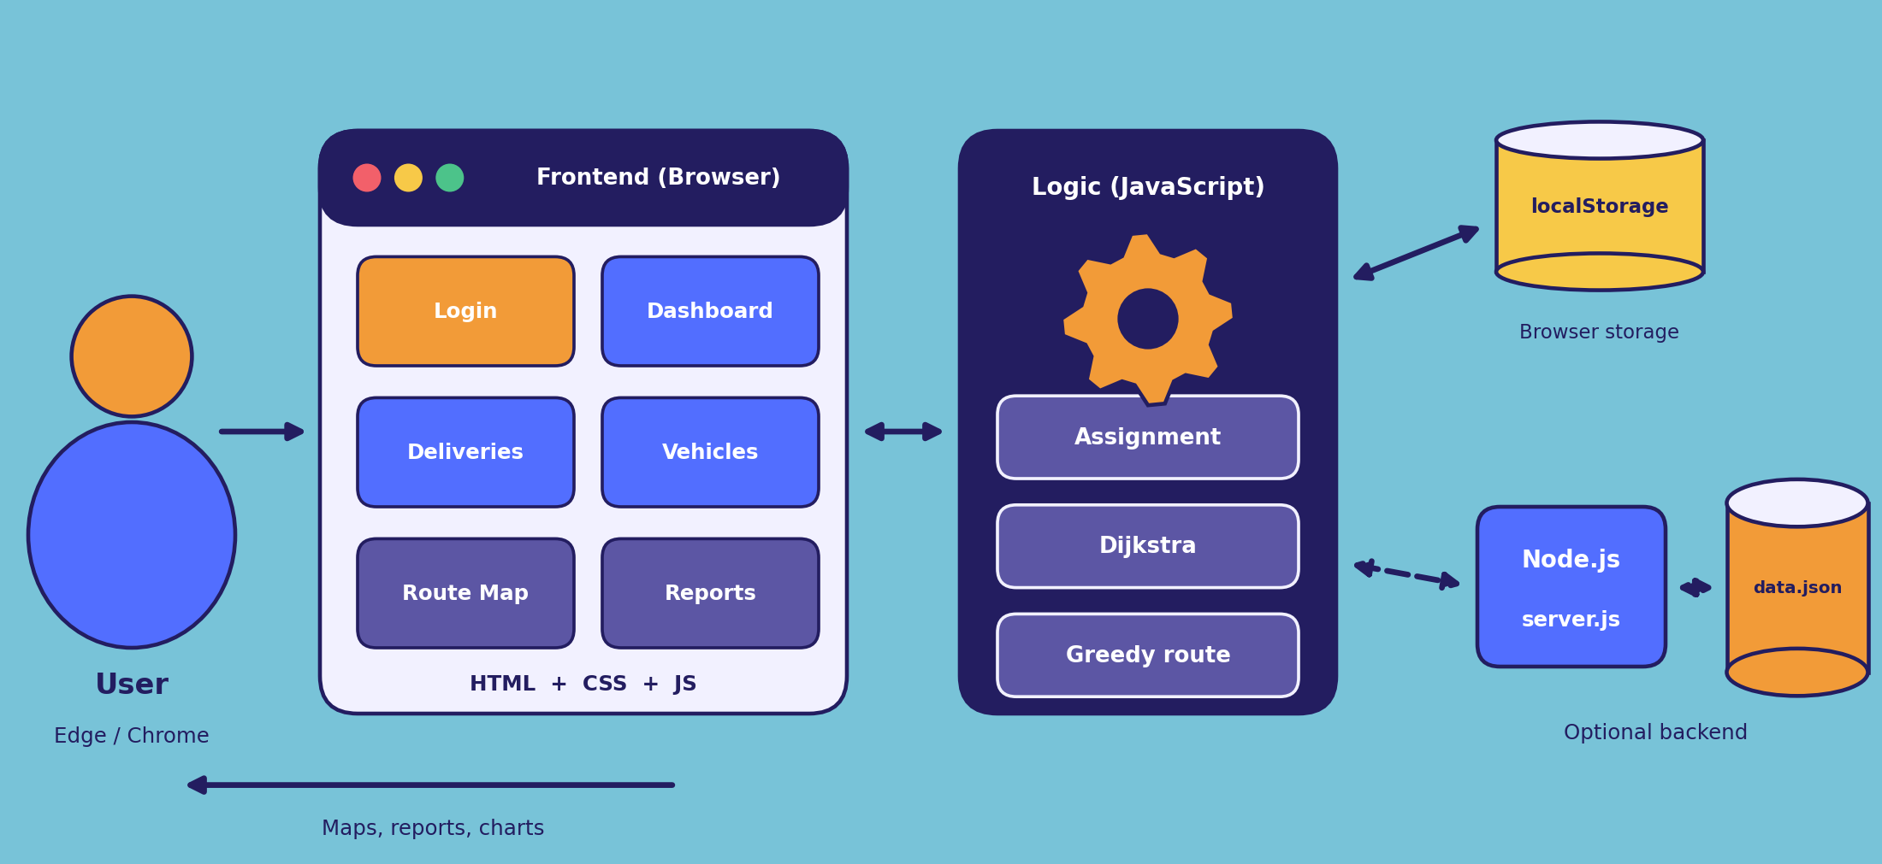
System Architecture

Slide 9
Algorithms and Results
Dijkstra shortest path
Greedy nearest-stop
Greedy first-fit assignment
Finds the shortest road path between locations. Baseline: a separate round trip per stop.
Visits the closest unvisited stop next, then returns to the warehouse.
Sorts deliveries by size and fills the first vehicle with enough space.
Active Delivery Records
Vehicles Used
Total Route Distance
Best Method Chosen
Pending and in-transit orders are routed
Only vehicles that receive packages
Sum of the routes of all vehicles
Greedy or Dijkstra, whichever is shorter

Slide 10
Thank You
Presented by
M. Laasya Sri 2520090196
M. Rajini 2520090197

